Slide 1



Control and Automation IC2122 Robotics Lab with VREP
Instructor: Louis Wong
Industrial Centre
The Hong Kong Polytechnic University

Slide 2
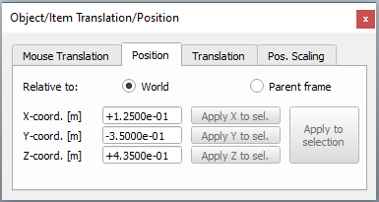
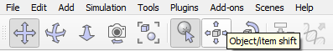
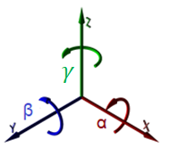
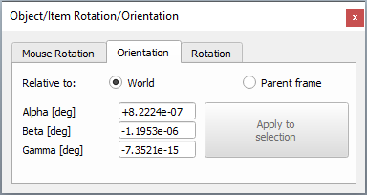
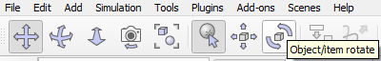

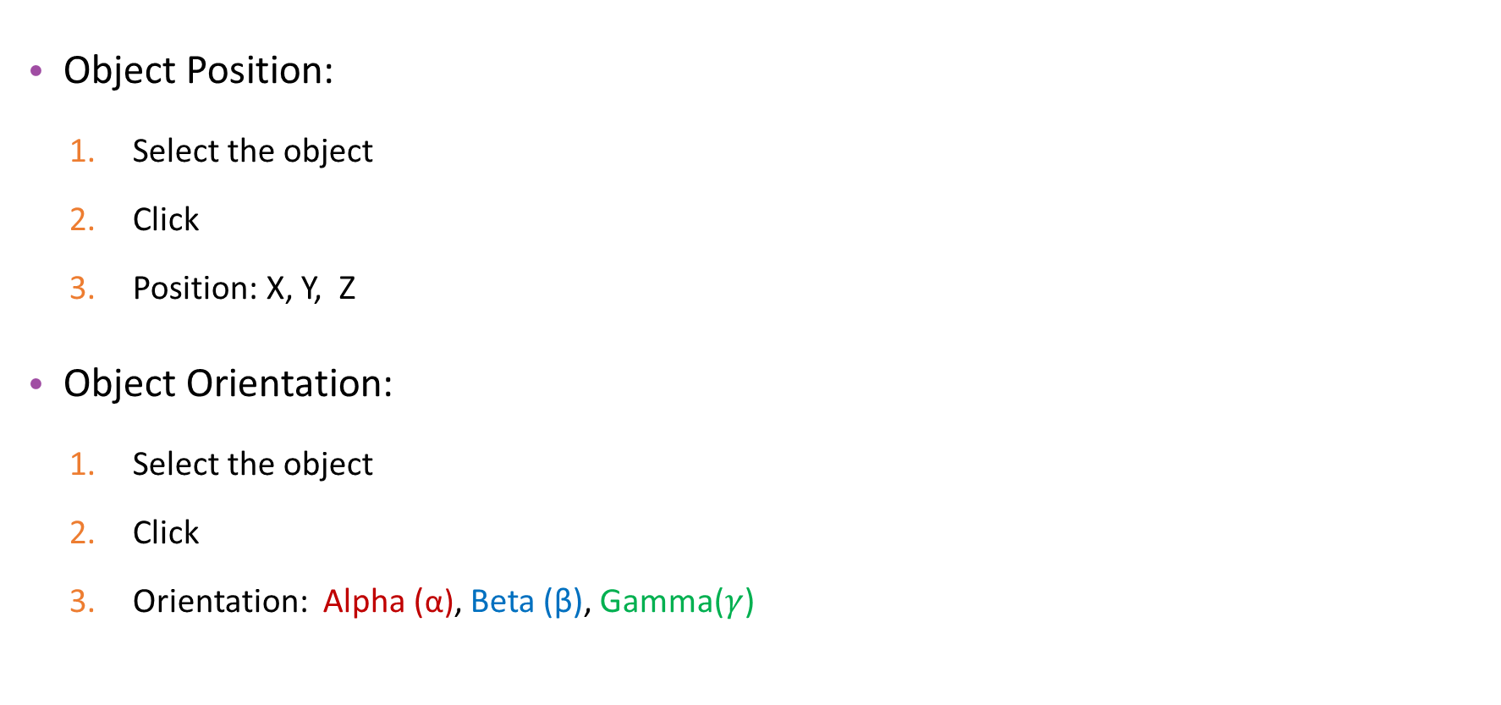
V-REP Tools
Object Position:
Select the object
Click
Position: X, Y, Z
Object Orientation:
Select the object
Click
Orientation: Alpha (α), Beta (β), Gamma($γ$)

Slide 3
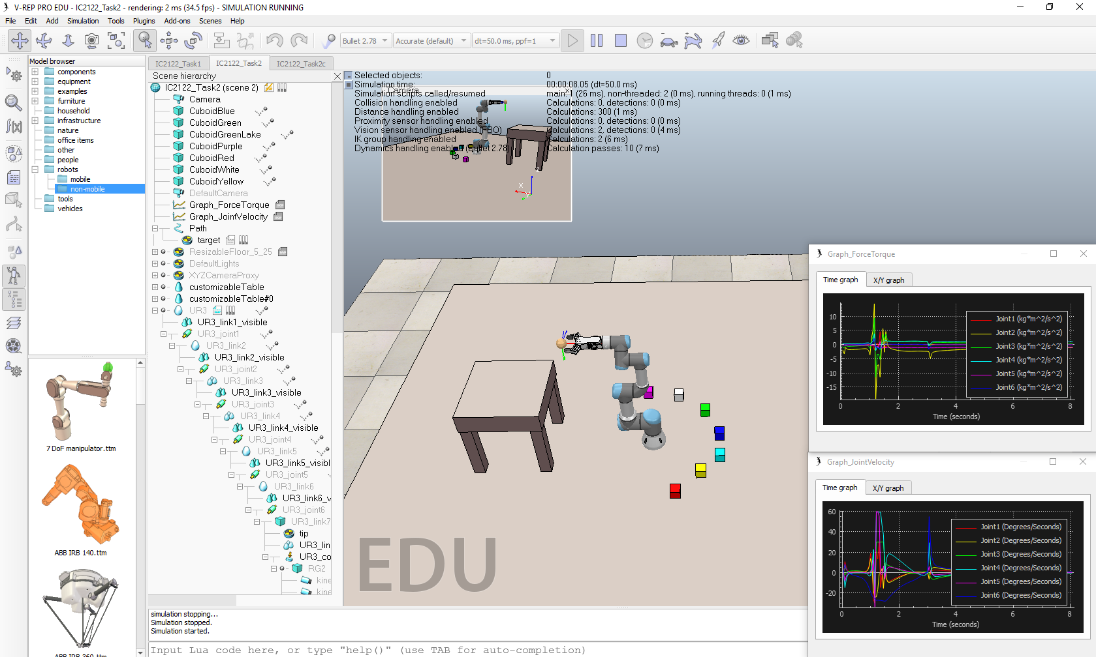
Task 2: Inverse Kinematics

Slide 4
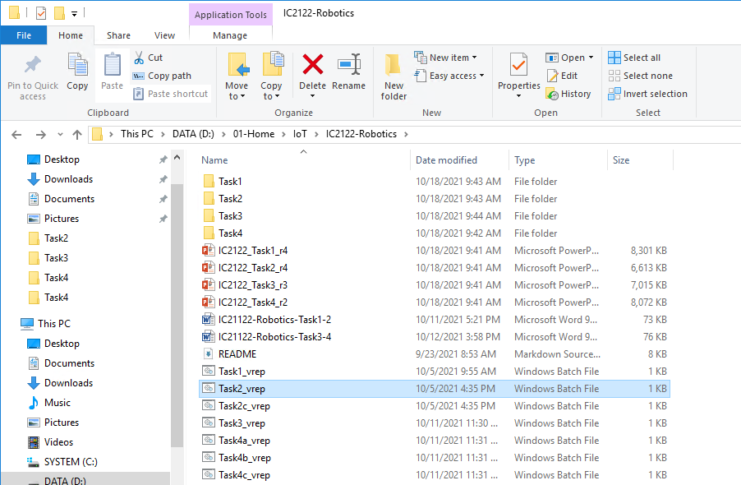
Start-up – V-REP
Start the V-REP (Task2_vrep.bat)
D:\01-Home\IoT\IC2122-Robotics
Double-Click

Slide 5
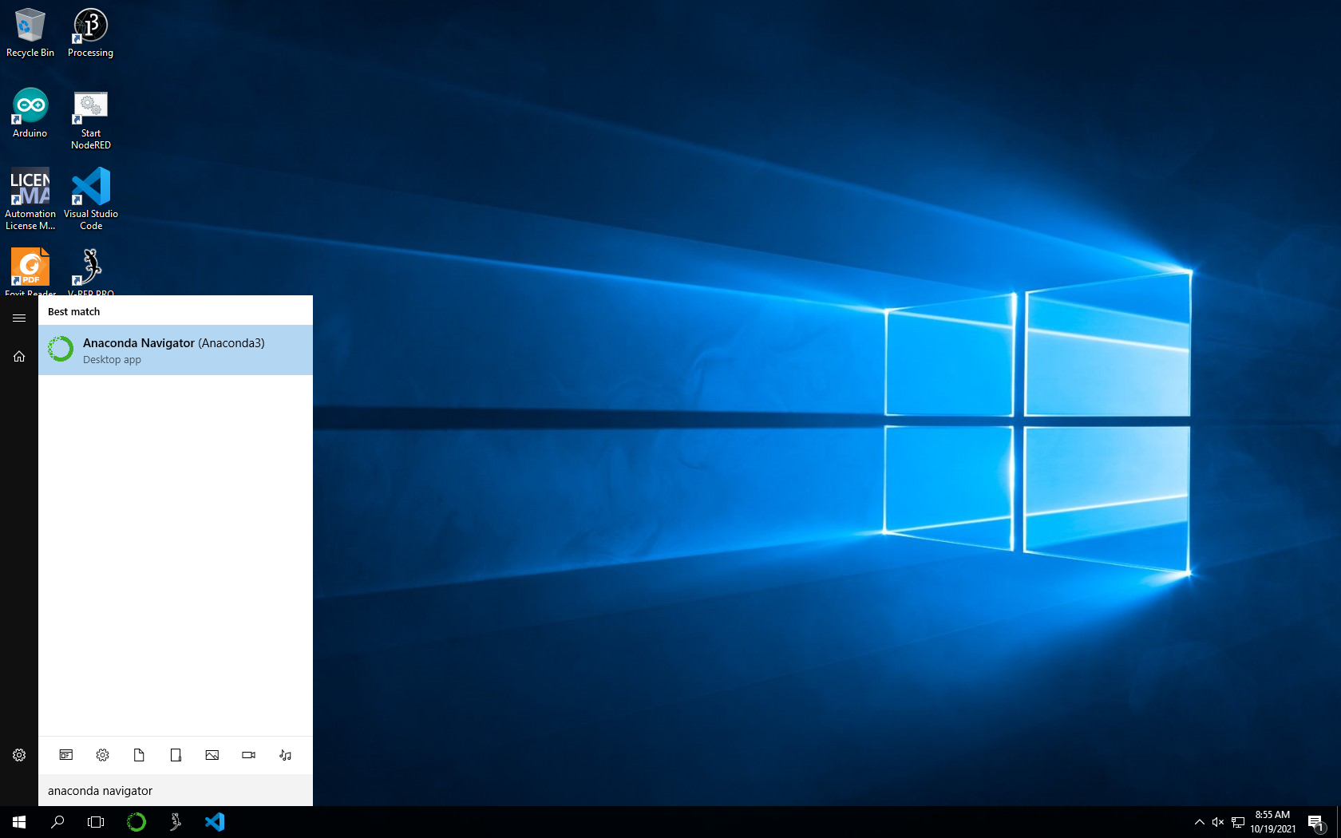
Start-up – Anaconda Navigator
Start the Anaconda Navigator on Taskbar or search Windows
Search Anaconda Navigator and click the icon
OR
Click Anaconda Icon

Slide 6
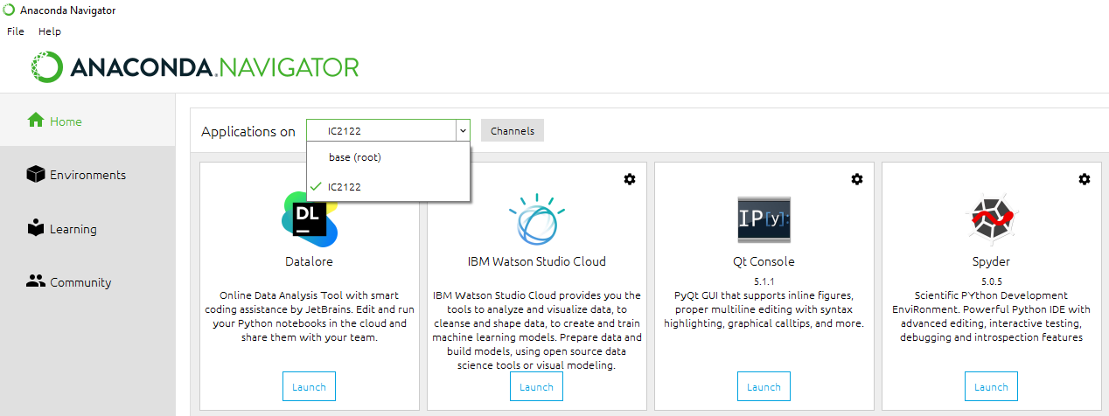
Start-up – Spyder
Launch Spyder
2
1
3
4

Slide 7
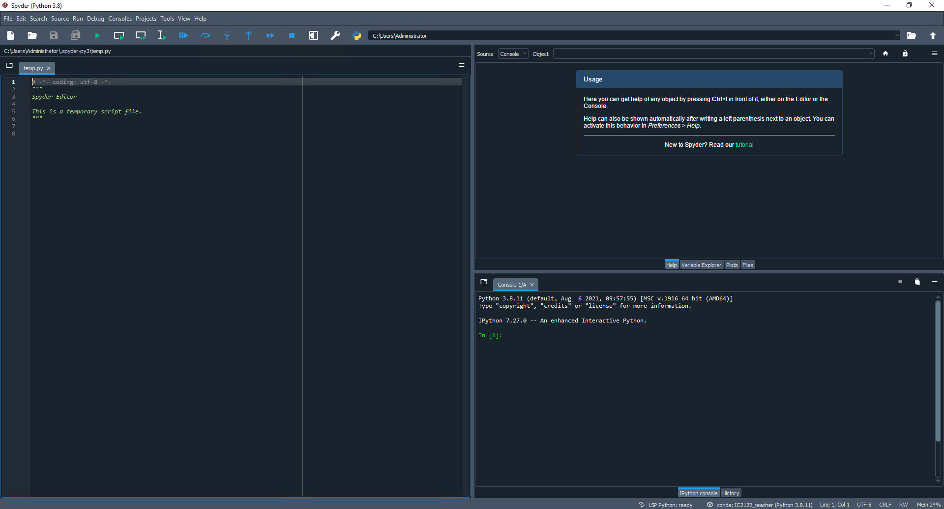
Start-up – Spyder
Toolbar
Help
Editor
IPython Console
Status Bar

Slide 8
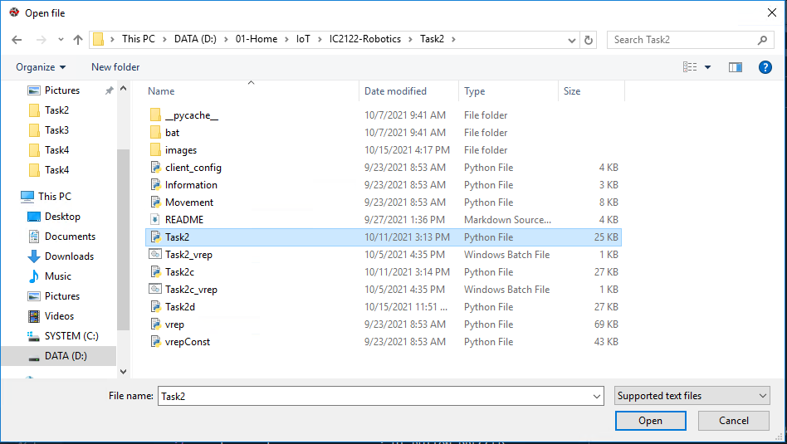
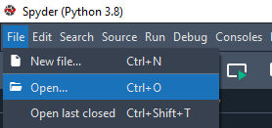

Start-up – Spyder
D:\01-Home\IoT\IC2122-Robotics\Task2
Open Python file at editor
Run the program at Spyder
3
1
2
4
6
5

Slide 9
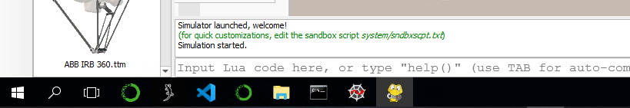
Start-up – Control panel window
Control panel window will be appeared after running the program
After switching to the V-REP, the control panel window will be hidden
Click the Control panel window icon to open it.
Click this icon

Slide 10
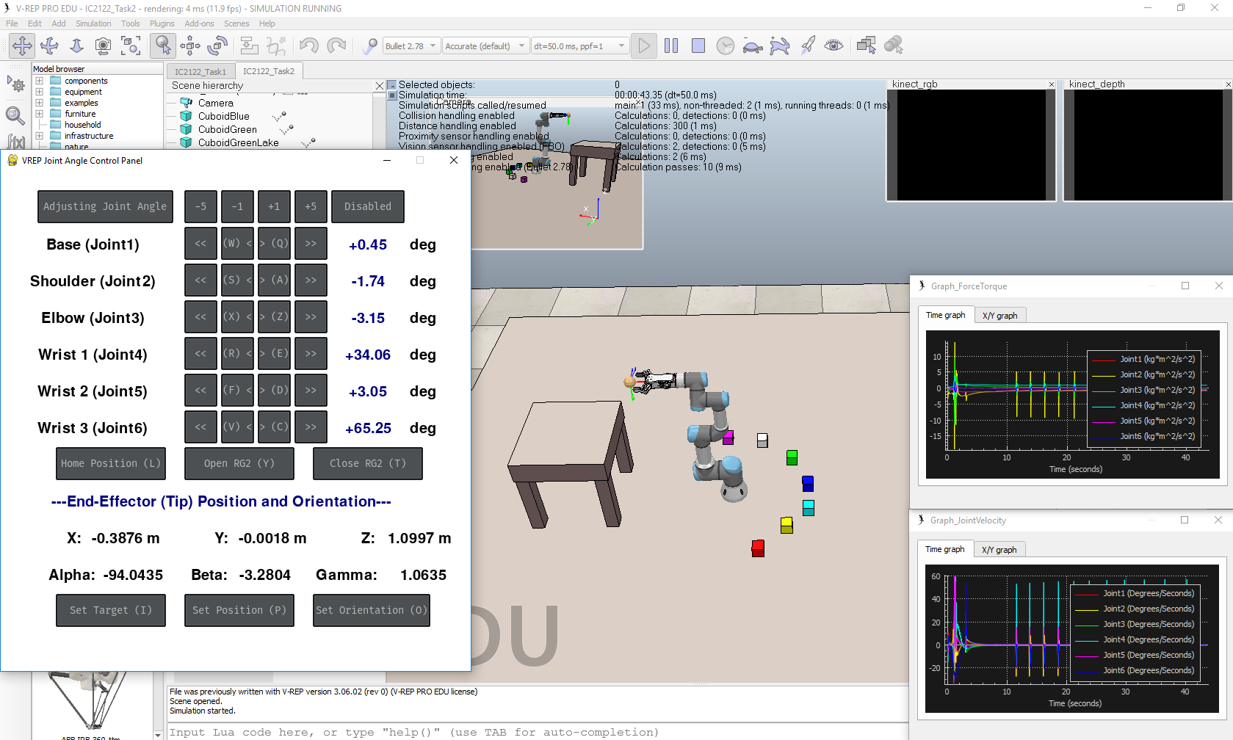
Start-up
V-REP interface:

Slide 11
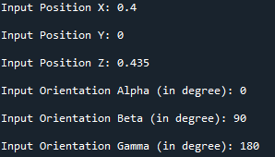
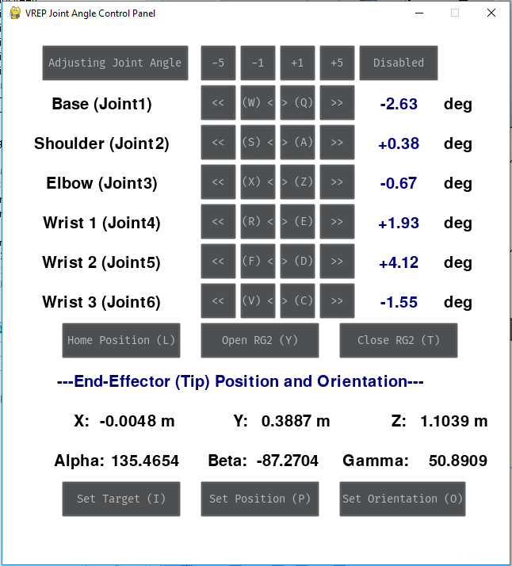
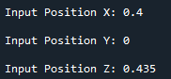
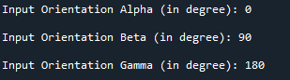
V-REP Joint Angle - Control Panel
Target Configuration
Set Target (T)
(Input your value at Console)
Set target Position (X, Y, Z)
Set target Orientation (Alpha, Beta, Gamma)
Set Position (P)
(Input your value at Console)
Set target Position (X, Y, Z)
Set Orientation (O)
(Input your value at Console)
Set target Orientation (Alpha, Beta, Gamma)
Joint Angle configuration disabled

Slide 12
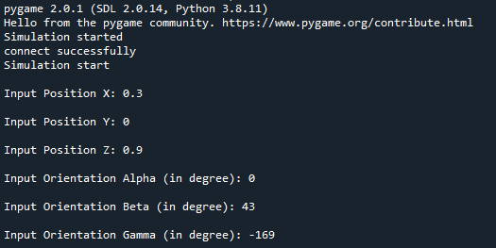
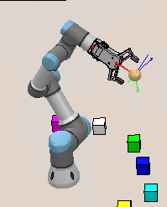
V-REP Joint Angle – How to use "Set Target" button?
How to use the "Set Target" button?
Click "Set Target" button
Switch to the Spyder IPython Console
Input Position or Orientation value
Press "Enter" to confirm the inputted value
Repeat above two steps
(X, Y, Z, Alpha, Beta, Gamma)
The UR3 will be moved
based on the setting
Step 1
Step 2
Step 3&4
Step 5
Step 6

Slide 13

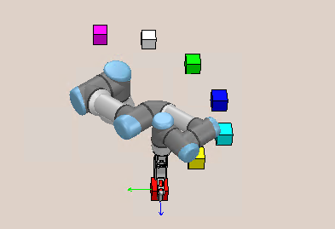
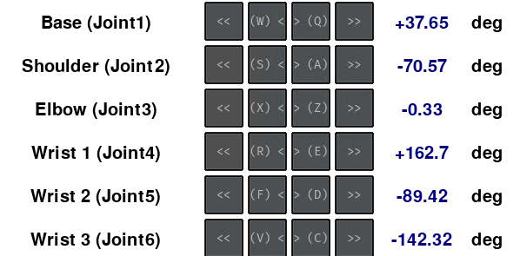
IC2122 – Task 2a
Task 2a: Move the end-effector to the RED block using Inverse Kinematics and write down the procedure.
(Remark: Adjust the end-effector vertically to the ground )
Red Block Position: | Position X | Position Y | Position Z
 | 0.125 m | -0.35 m | 0.435 m
Final Goal
Joint Angle

Slide 14
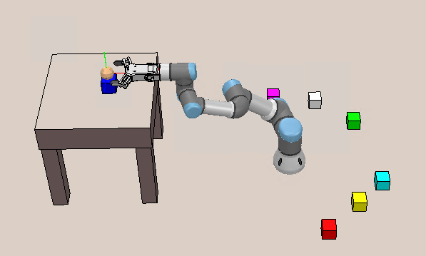
IC2122 – Task 2b
Task 2b: Pick the BLUE block and place it on the table using Inverse Kinematics
and write down the procedure.
(Remark: Make the end-effector vertically to the ground for picking
and horizontally to the table for placing)
Final Goal
BLUE Block original Position: | Position X | Position Y | Position Z
 | 0.35 m | 0.0225 m | 0.435 m
BLUE Block final Position: | Position X | Position Y | Position Z
 | ≈ -0.667 m | ≈ 0 m | 0.846 m

Slide 15
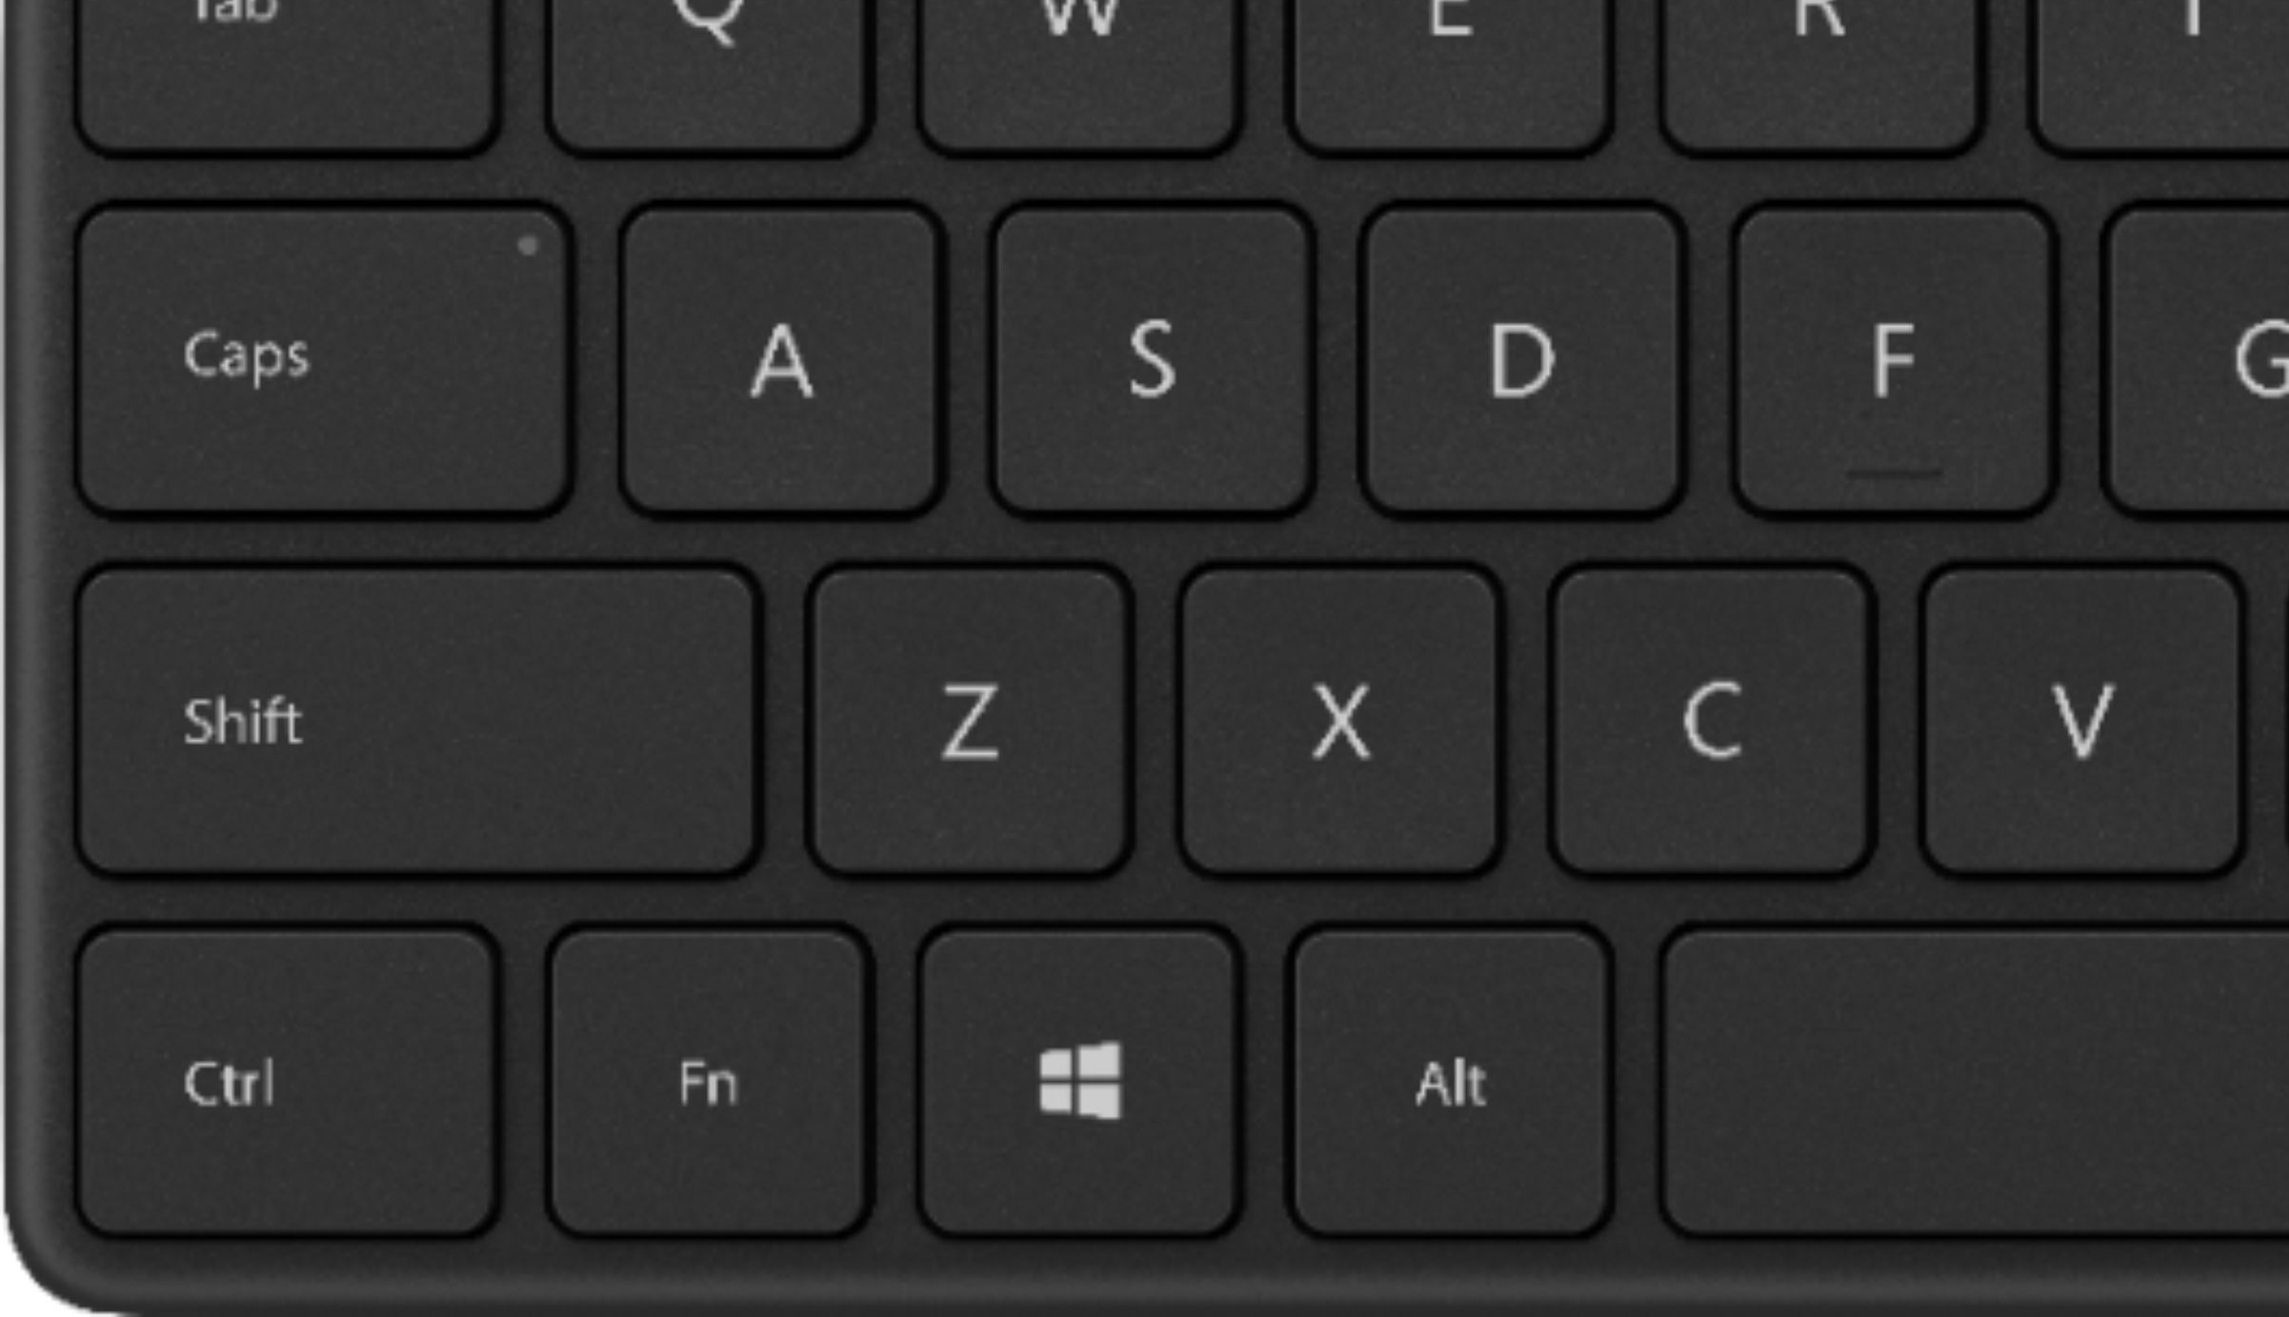
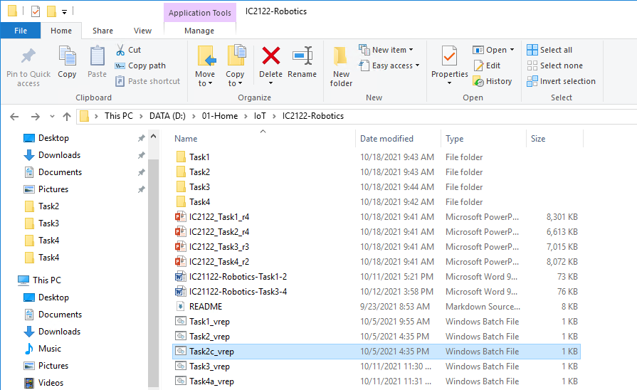

IC2122 – Task 2c
Stop the program by holding “Ctrl” and clicking “C” (IPython console)
Open a new console by holding “Ctrl” and clicking “D” (IPython console)
Close the previous V-REP
Start a new V-REP (Task2c_vrep.bat)
Switch to Spyder and open Tack2c.py
Run the program (Spyder)
(D:\01-Home\IoT\IC2122-Robotics\Task2)
Double-Click

Slide 16
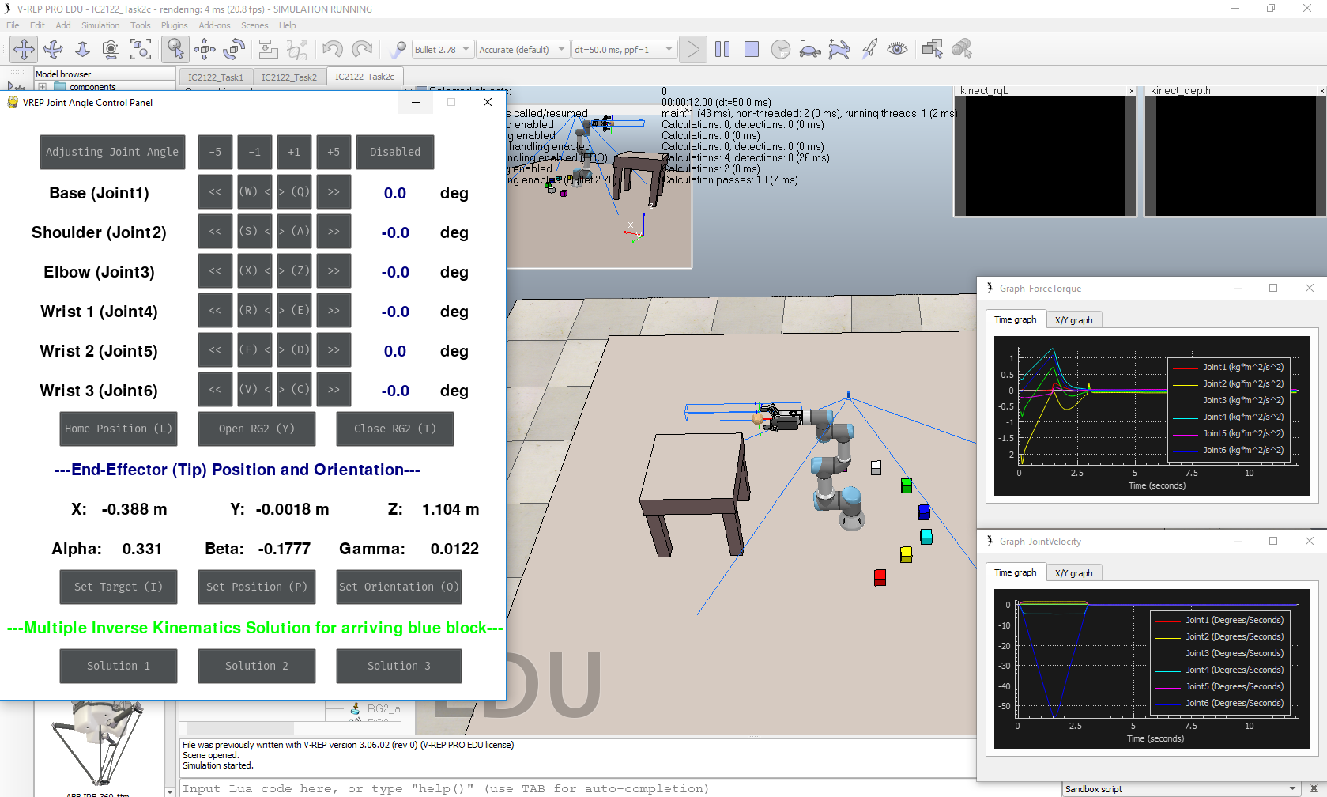
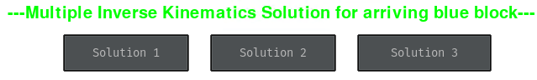
IC2122 – Task 2c
Task 2c interface
Task 2c: Moving the end-effector to the BLUE block using
Inverse Kinematics often provides different solutions or approaches.
Observe and discuss the below 3 solutions.
Suggest the method to create the unique solution (e.g. guide)

Slide 17
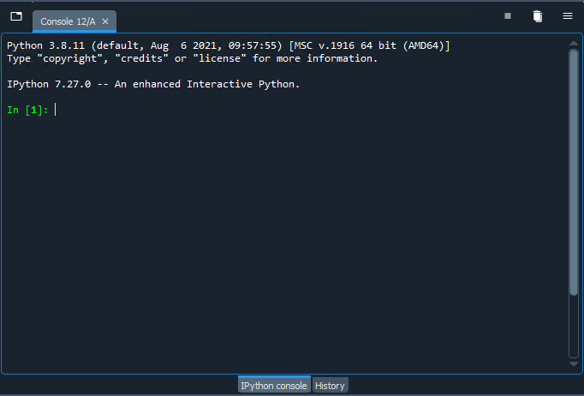
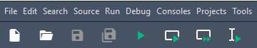
Task2 – Troubleshoot
Step 1: Switch to the Spyder IPython Console
Step 2: Stop the program by holding “Ctrl” and clicking “C”
Step 3: Open a new console by holding “Ctrl” and clicking “D”
Step 4: Stop the V-REP simulation
Step 5: Run the program at Spyder
Step 1
Step 3
Step 2
Step 4
Step 5

Slide 18
Q&A

